Slide 1


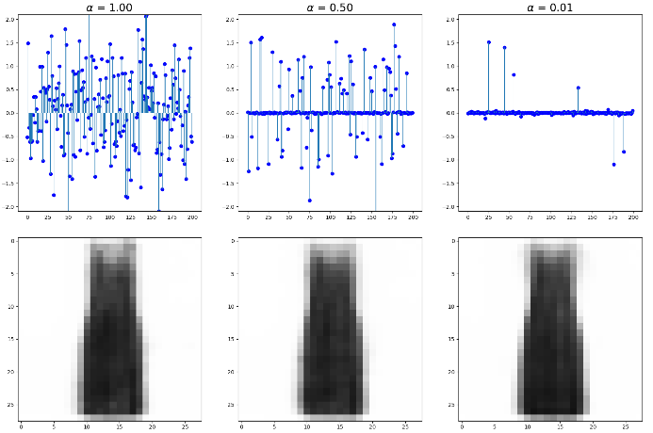
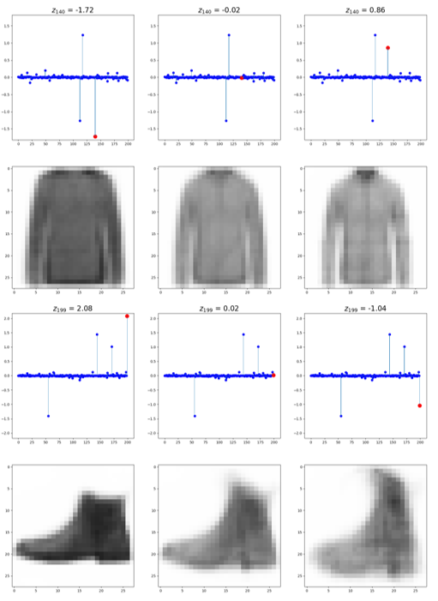
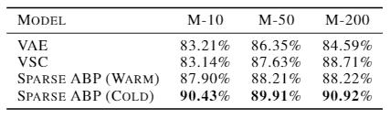
Learning Sparse Representations with Alternating Back-Propagation
Hanao Li, Tian Han
Department of Computer Science, Stevens Institute of Technology
Objectives and Contributions
Experimental Results
Experimental Results (Cont’d)
In this work, we are interested in learning a sparse representation of the latent variables. This can increase interpretability of each latent dimensions and lead to more robust classifier.
We present a new learning method to obtain such sparse representations for the latent variables using spike and slab distribution as our prior belief.
The model is trained using maximum likelihood estimation and short-run Monte Carlo Markov Chain sampling (Langevin Dynamics) is adopted to obtain the posterior distribution of the latent variables.
We demonstrate the gradient of log-prior can be regarded as a regularization term that penalizes small values of latent variables with stronger power to push them towards 0 , and thus help enforcing sparsity to some extent.
Our preliminary experimental results suggest that our model can learn a sparse representations of the latent variables. These sparse latent codes can have increased explainability and boosted robustness of the classifier while preserving important information using MNIST and FashionMNIST dataset.
This figure below shows that our training algorithm can effectively learn a sparse representation of the latent variables.
This figure below shows that our model can lead to better interpretations of the latent variables. We can see the shoulder width of the cloth and height of the shoes are explained by the corresponding latent dimension.
The table below shows our learned sparse representations can lead to high accuracy of the classifier which means that we have a more robust classifier.

